Slide 1

대한민국의 상징
Symbols of Korea
Notes:
대한민국의 상징 Symbols of Korea. What types of symbols do countries use? The symbol of a country informs the international community of the existence of a country. Symbols contain historical culture and ideas. Some examples of symbols are national flags, national anthems, and national flowers.

Slide 2
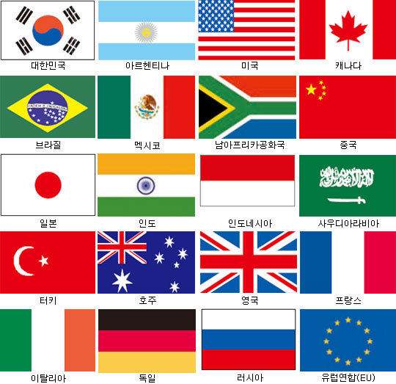
나라별 국기들
Notes:
Each country has their own distinct flag. Can you spot America’s flag? Can you find Korea’s flag? Are there any more flags you recognize?

Slide 3
한국의 정식 이름
대한민국 大韓民國
Republic of Korea
GREAT HAN PEOPLE COUNTRY
Notes:
The country is referred to as Korea, Republic of Korea, and South Korea, but its official name is ‘The Republic of Korea, 대한민국.’
<click> (글씨 나온 후 설명 자동재생) 대 means Great, 한 means Han, 민 means People, and 국 means Country.

Slide 4
국호(나라 이름)의 변천사
대한제국
1897-1910
Great Korean Empire
임시정부
1919-1948
Provisional Government
대한민국
1948-now
The Republic of Korea
Notes:
The name of Korea has changed throughout history. It started as 대한제국 the Great Korean Empire, then changed to 대한민국 임시정부 the Provisional Government, then finally to 대한민국 the Republic of Korea.
고종 of the 조선 Dynasty declared to change the name of 조선 to 대한제국, the Great Korean Empire. During the Japanese colonial period, 대한민국 임시정부, the Provisional Government was established, and after independence from Japan on August 15, 1945, the name 대한민국 has been used since July 17, 1948.

Slide 5
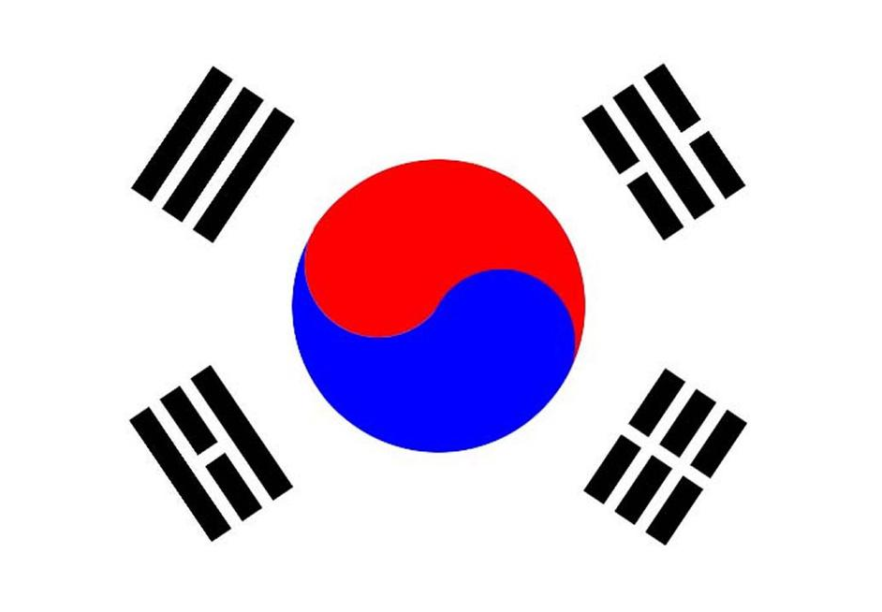
태극기
Taegeukgi
한국의 국기
Flag of Korea
Notes:
This is the national flag of the Republic of Korea, 태극기. Have you seen it before? What shapes do you see?

Slide 6
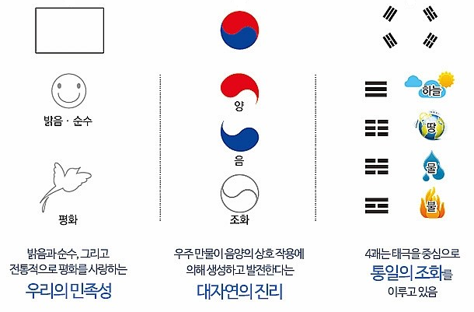
태극기의 의미
건
곤
감
리
Notes:
We will now learn the meanings of the 태극기. The white background stands for brightness and purity which represent the Korean identity and the people’s disposition for peace. The circle shape located in the center of the flag is made up of 음 and 양 and together represent the harmony that the world strives for. The four black symbols on the corners of the flag are 건곤감리. The three stripes on the top left are 건 and represent the sky. The four stripes on the bottom left are 리 and represent fire. The five stripes on the top right are 감 and represent water. The six stripes on the bottom right are 곤 and represent land. Together the flag signifies a harmonious world, brightness, purity, and peace.

Slide 7
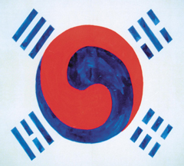
태극기의 역사
박영효의 태극기
(1882년)
고종의 명을 받은 박영효가 일본에 가면서
태극· 4괘 도안 사용
Notes:
When was the 태극기 created? Let’s find out what kinds of 태극기 existed before. As each country uses their national flag to represent their country, in the 18-19th century, opinions about creating a national flag started to appear in Korea. This 태극기 is the first Korean flag used by 박영효 when 고종 sent him to Japan as a diplomat. Can you see the 태극 pattern, the circle in the middle and four stripe patterns on the corners?

Slide 8
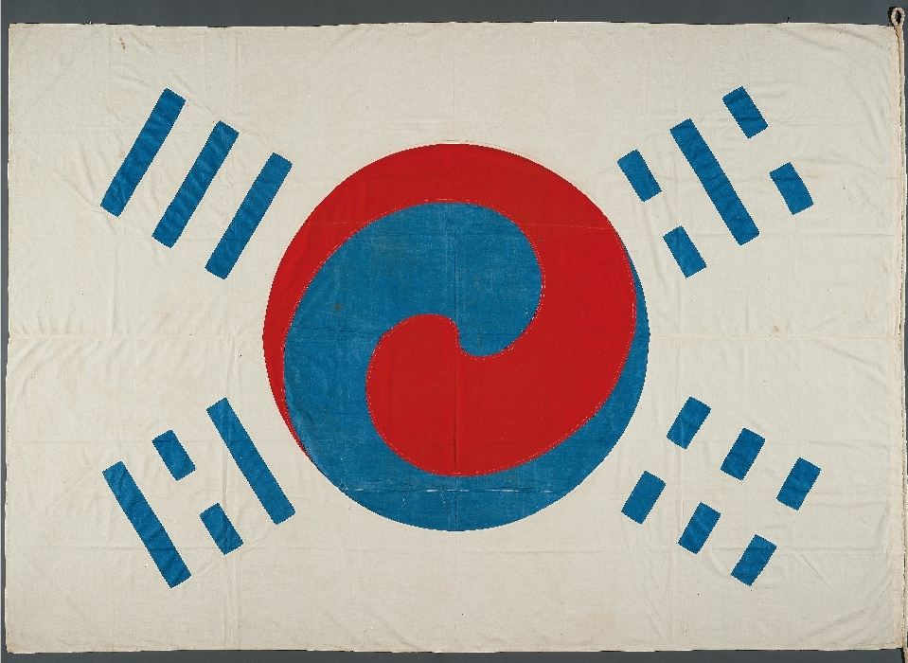
데니의 태극기
(1888년)
고종이 미국 출신
외교고문 데니에게
하사한 태극기
Notes:
This 태극기 was given to Denny, an American diplomatic advisor, by 고종.

Slide 9
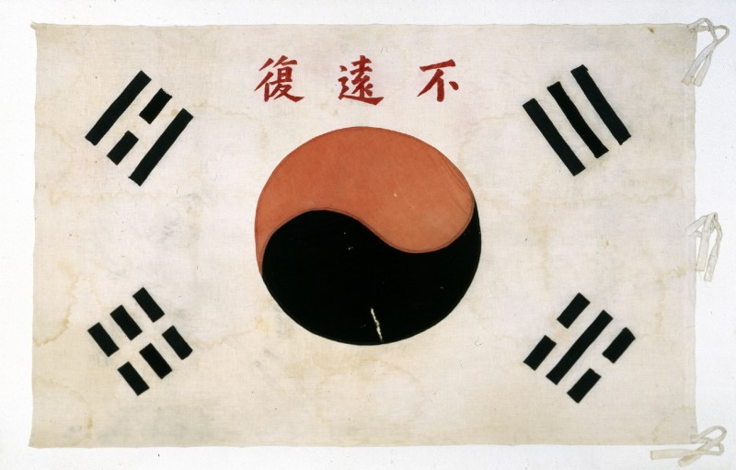
불원복 태극기
(1907)
의병장 고광순이
항상 옷 속에 넣고 다녔다는 태극기
불원복 – 광복이 멀지 않았다
Notes:
This is a 태극기 that the leader of the Righteous Army, 고광순 always carried in his clothes. It has Chinese characters meaning ‘Independence is coming soon’.

Slide 10
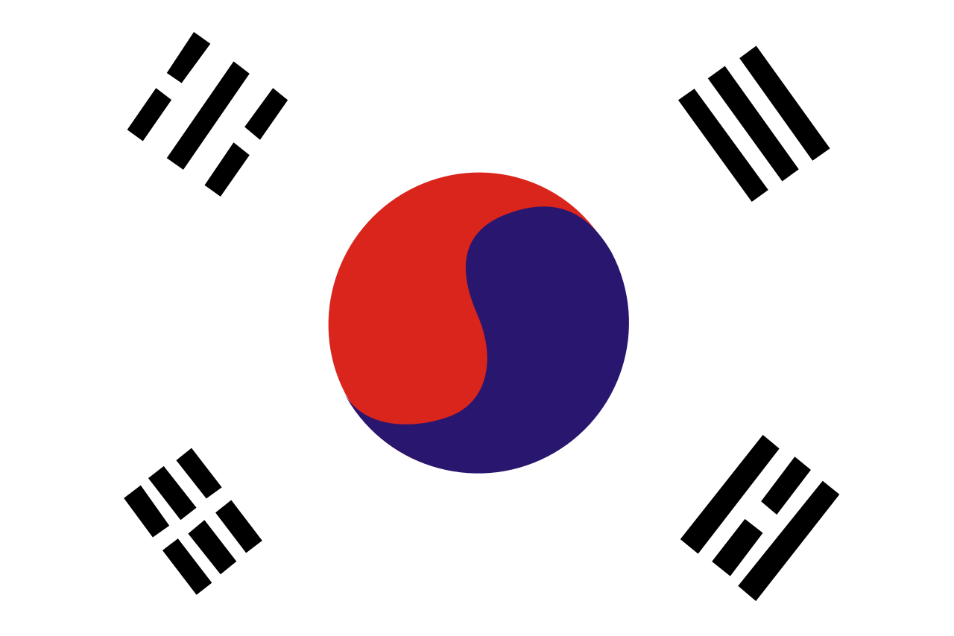
3·1 운동 태극기
(1919년)
3·1 운동 당시에
평양 숭실학교에서
만든 태극기
Notes:
This 태극기 was made by college students during 3·1운동, the March 1st Movement, and they would shout ‘대한독립 만세’ meaning ‘Long live Korea’s Independence’.

Slide 11
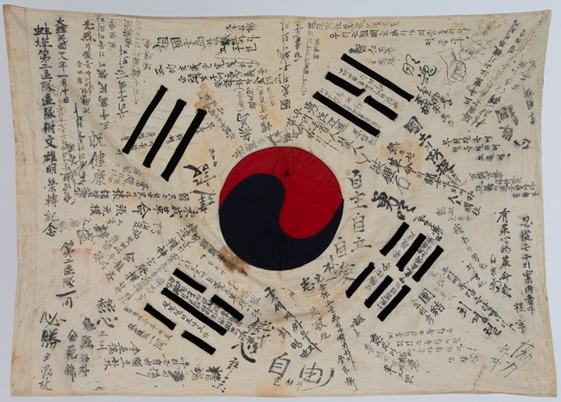
한국광복군
서명문 태극기
(1945)
Notes:
This is a 태극기 with names and wishes written by the people who participated in the Independence Movement. Look at the names and wishes. Can’t you feel the desperate feeling of those who fought for Korea’s independence?

Slide 12
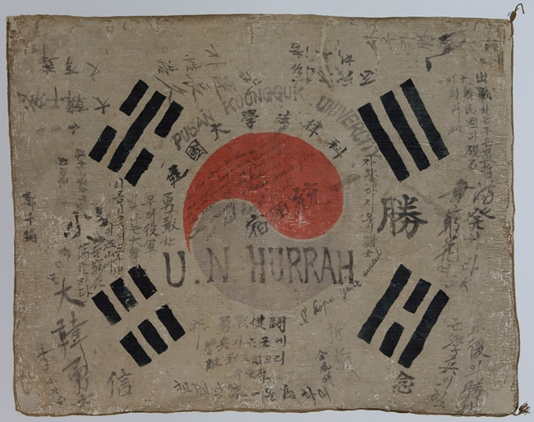
건국법정대학
학도병 서명문 태극기
(1950)
한국전쟁 당시
대학생들이
서명한 태극기
Notes:
This is a 태극기 with names and wishes of college students who participated in the Korean War. Even in this 태극기, you can feel the hearts of those who loved the country. After the Korean government was established in 1948, the method of making the National Flag was confirmed and announced through <The National Flag Making Act>. In 2007, various laws related to 태극기 were enacted to systematically control the national flag.

Slide 13
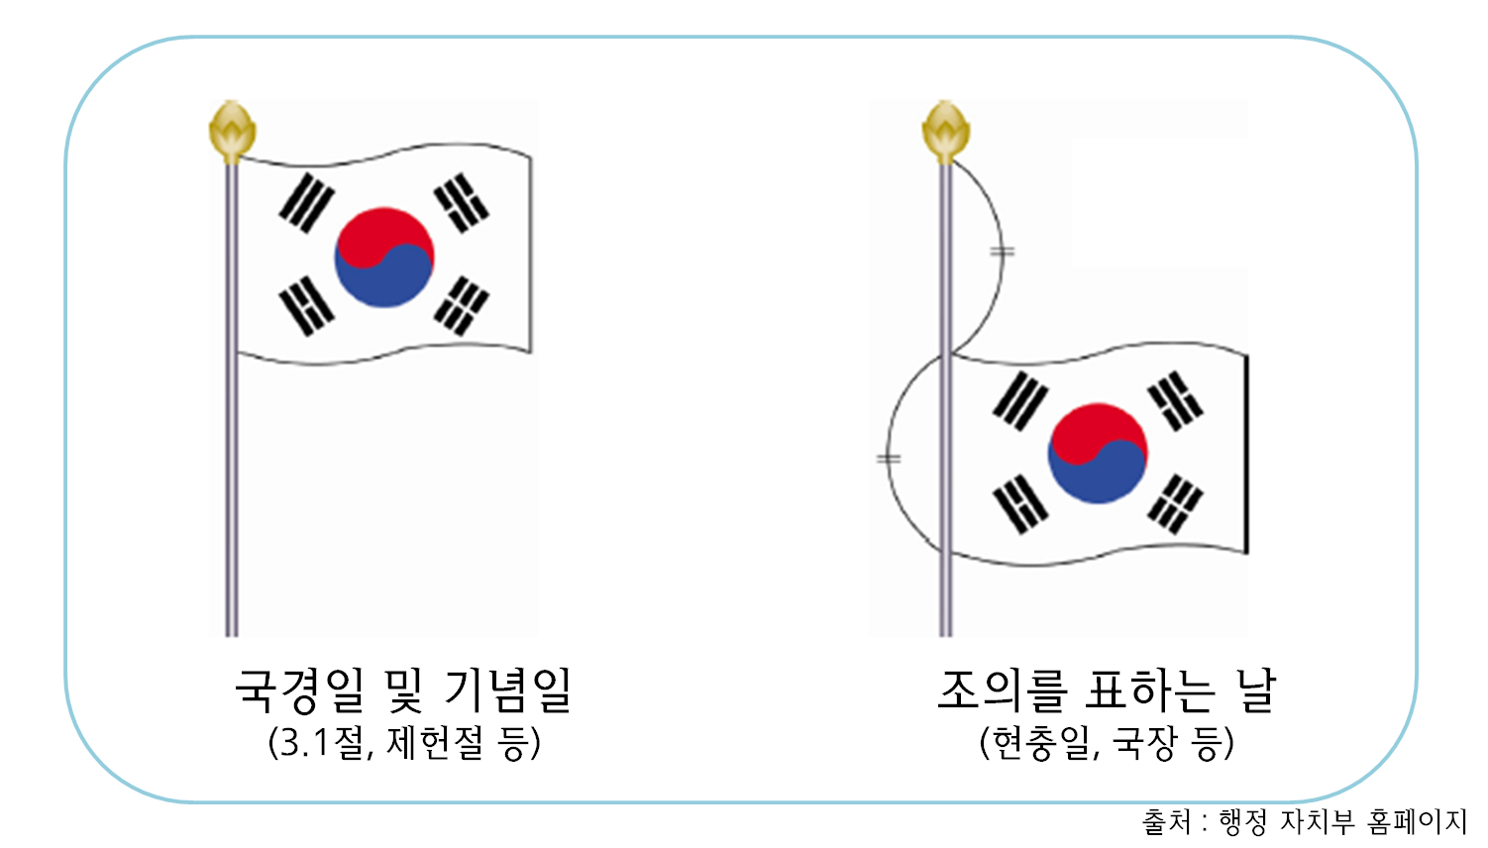
태극기 다는 날
3월 1일 | 3·1 절 | The March 1st Day
7월 17일 | 제헌절 | Constitution Day
8월 15일 | 광복절 | The National Liberation Day
Notes:
When is the 태극기 hoisted? There are dates set by the country. March 1, 3·1절, July 17th, 제헌절 Constitution Day, and August 15th, 광복절 The National Liberation Day.

Slide 14
태극기 다는 날
10월 1일 | 국군의 날 | Armed Forces Day
10월 3일 | 개천절 | National Foundation Day
10월 9일 | 한글날 | Korean Alphabet (Hangeul) Day
Notes:
October 1st, 국군의 날 Armed Forces Day, October 3rd, 개천절 National Foundation Day, and October 9th, 한글날 Korean Alphabet Day

Slide 15
태극기 다는 날
6월 6일 | 현충일 | Memorial Day
 | 국장 | National Funeral
Notes:
현충일 Memorial Day on June 6th, is a day to honor and think of those who passed away while working for the country, so the 태극기 is lowered. Although there is no set date when an important figure passes away, 국장 National funeral, the 태극기 is lowered.

Slide 16
국기에 대한 맹세
(Pledge of allegiance to the flag)
나는 자랑스러운 태극기 앞에 자유롭고 정의로운 대한민국의 무궁한 영광을 위하여 충성을 다할 것을 굳게 다짐합니다.
I, standing before the noble Taegeukgi, solemnly pledge allegiance to the Republic of Korea, to its glory, liberty and justice.
Notes:
Let’s read the oath on the flag.
<click> (태극기와 글씨 나온 후 자동재생) 나는 자랑스러운 태극기 앞에 자유롭고 정의로운 대한민국의 무궁한 영광을 위하여 충성을 다할 것을 굳게 다짐합니다.
<click> (글씨 나온 후 자동재생) I, standing before the noble 태극기, solemnly pledge allegiance to the Republic of Korea, to its glory, liberty and justice

Slide 17
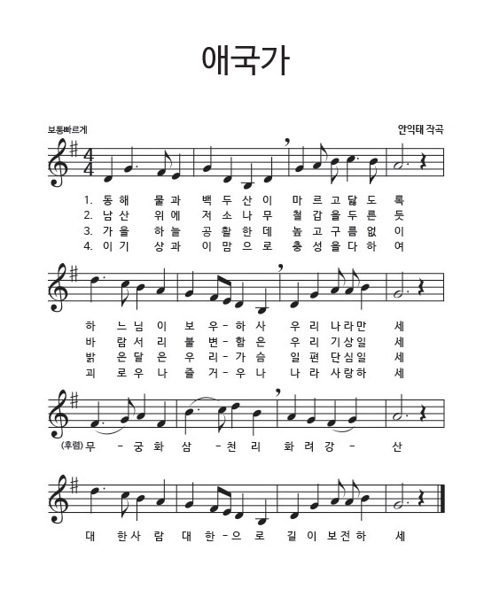
애국가
National Anthem of Korea
대한민국의 국가
나라를 사랑하는 노래
Notes:
The national anthem of Korea is the 애국가. “애” means love, “국” means country, and “가” means song. 애국가 the name itself means a song that loves the country.

Slide 18
애국가의 역사
조선 말 개화기 이후부터 노랫말과 곡조 사용
처음에는 올드 랭 사인(Auld Lang Syne)의 곡을 사용
1936년 안익태가 작곡을 함
대한민국 임시정부의 채택으로 현재 애국가 완성
애국가 (올드 랭 사인)
Notes:
The melody of the national anthem was different from the melody it is now. At first, they sang the national anthem to the Auld Lang Syne melody from Scotland. In 1936, 안익태 wrote the song to the lyrics of the 애국가.
<click>Then the Korean Provisional Government adopted the national anthem as we know it today. Now, let’s listen to what the 애국가 sounded like before?
<click> ‘올드 랭 사인 애국가’ 재생

Slide 19
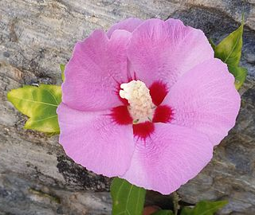
무궁화
National Flower of Korea
대한민국의 국화
영원히 피고 또 피어서 지지 않는 꽃
Notes:
The national flower of Korea is 무궁화 also known as the rose of Sharon. It was chosen as the national flower because the flower blooms all the time and will live forever.

Slide 20
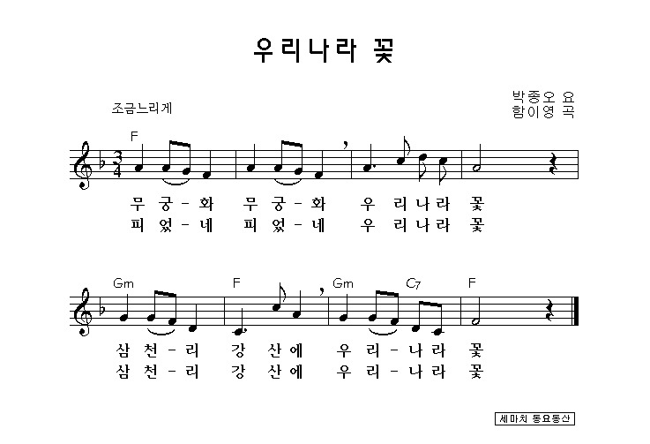
Notes:
Let’s listen to a song about 무궁화, the national flower of Korea!
<click> ‘우리나라 꽃’ 재생

Slide 21
자료 출처
애국가 올드 랭 사인: https://www.youtube.com/watch?v=xf7-uVQcIiU 에서 음원 추출
우리나라 꽃: https://www.youtube.com/watch?v=O4EMTuEOsYs 에서 음원 추출

